Slide 1
Prototype Presentation Group Members: Dorian Taponzing Donfack Aurelien Fredy Takou Tene Yann Djoumessi Donfack Leopold Sokoudjou Gatsing Manuella Koodjo Naoussi
SP-100 University AI Companion
CS 4850/02, Fall, 10/25/2024 – Sharon Perry

Slide 2
Agenda
Introduction
Objectives
Technologies
Development Life Cycle
Architecture
Mockup
Demo
Difficulties/Limitations
Additional Work
Conclusion

Slide 3

Introduction
In today’s fast-paced academic world, students often find themselves overwhelmed with choices—whether it’s selecting the right courses, seeking career guidance, or finding resources for their studies. Our AI University Companion is here to simplify that journey. Designed initially for Computer Science majors and soon expanding to other fields, this cutting-edge mobile app provides personalized career advice, curated study resources, and access to mentoring all in one place. What sets it apart is its ability to adapt to your unique academic progress, offering real-time, AI-powered guidance tailored to your goals. It's more than just a tool—it's your ultimate partner in navigating the complexities of university life, empowering you to make informed decisions and succeed.

Slide 4

Objectives
Personalized Academic Guidance: Tailored support for coursework and study.
Career Support: Assists students in exploring career paths and finding relevant opportunities.
Expansion: Platform initially targets CS students but will extend to other disciplines.

Slide 5




Technologies
Frontend: React Native + Redux
Backend: NodeJS with LangChain for RAG techniques
AI Integration: OpenAI GPT-3.5
Data Management: Firebase Authentication, Firebase Storage

Slide 6
Development Life Cycle
1. Project Planning and Requirement Gathering:
Weekly sessions to design the architecture and define system requirements.
Analysis of user needs and functional specifications.
2. Learning Phase:
Team members enhanced skills using Udemy courses on AI, backend, and mobile development.
Continuous skill-building to keep up with project needs.
3. Iterative Development and Agile Practices:
Sprint Planning: Weekly sprints for focused development efforts.
Task Assignment: Different aspects divided among developers for parallel progress.
Weekly Stand-Ups: Meetings to review progress, discuss challenges, and perform testing.
4. Testing and Integration:
Regular testing at the end of each sprint to ensure code quality.
Integration of individual components into a cohesive system.
5. Review and Feedback Loop:
Ongoing feedback from testing sessions to refine features and fix issues.
Continuous improvement based on user input and testing outcomes.
6. Deployment and Maintenance:
We have not yet work on the Final Deployment.

Slide 7
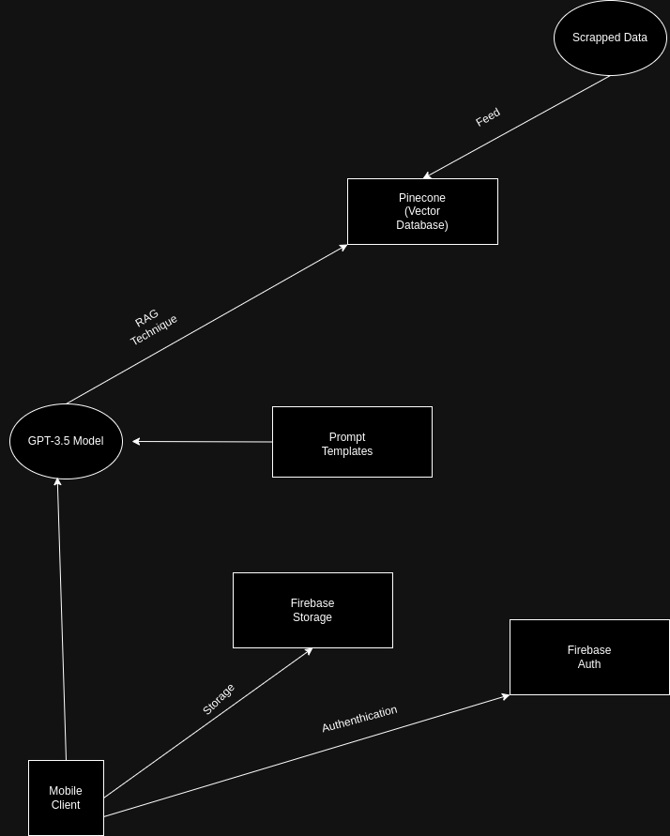
ARCHITECTURE

Slide 8
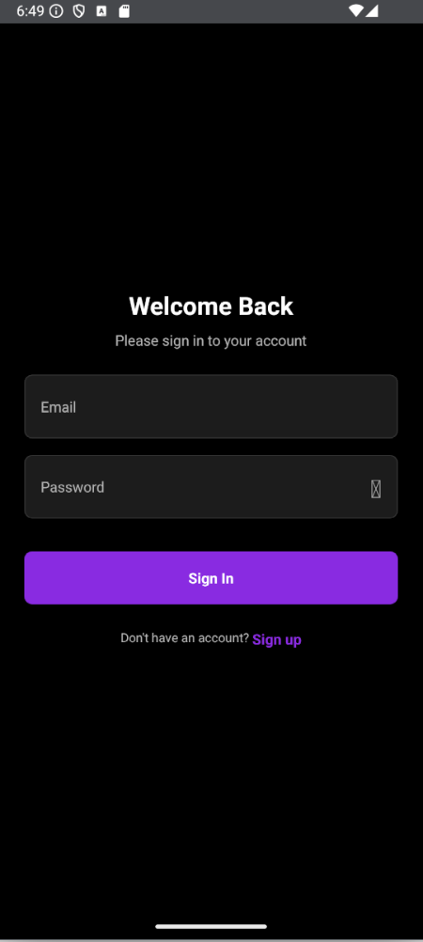
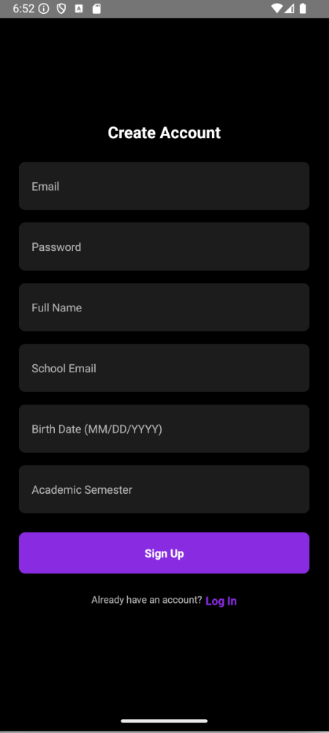
Mockup
AUTHENTICATION

Slide 9
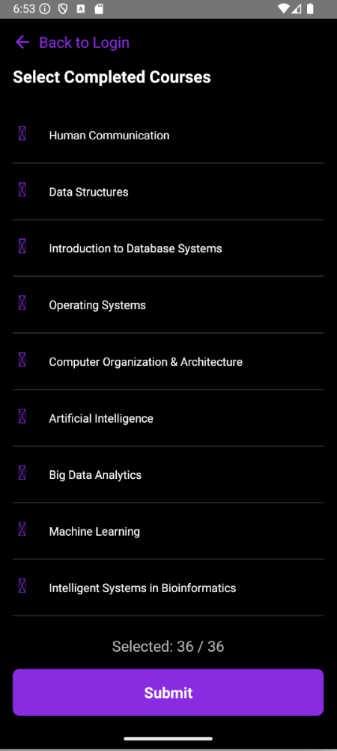
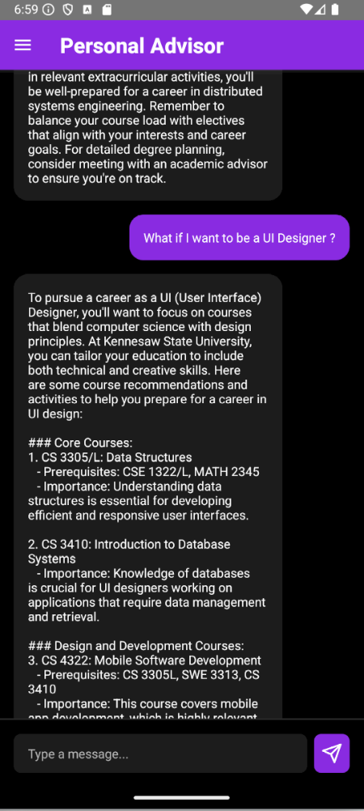
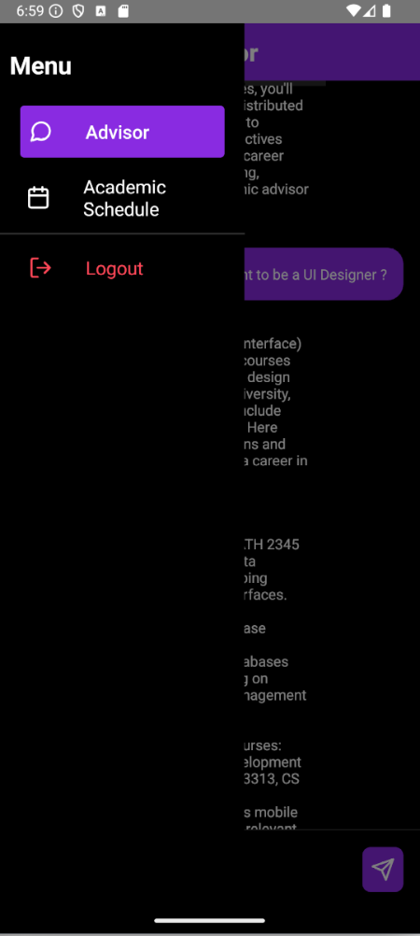
Mockup

Slide 10
Demo

Slide 11
Difficulties and Limitations
For the project, we are using the OPENAI API free tier.
Limits the access to most updated data.
Limits the size of context window once the limit on number of prompts/day has been reached.
Limits the understanding of a prompt.
Match users’ prompts to the right agent/tool.
Keyword Matching
Classifier-based Approach
Vector Similarity Matching

Slide 12
Additional work
Implement long-term memory: Ensure the AI retains context and user preferences for personalized, ongoing interactions.
Develop the schedule module: Create a feature to help students organize their academic activities, deadlines, and commitments.

Slide 13
Summary/Conclusion
The University AI companion is an innovative project that will improve the integration and interaction of a student to a new environment. Moreover, it will help them to stay focus and guide them through out their academic and professional lives.
We submitted our power point slides prior to this presentation.

Slide 14
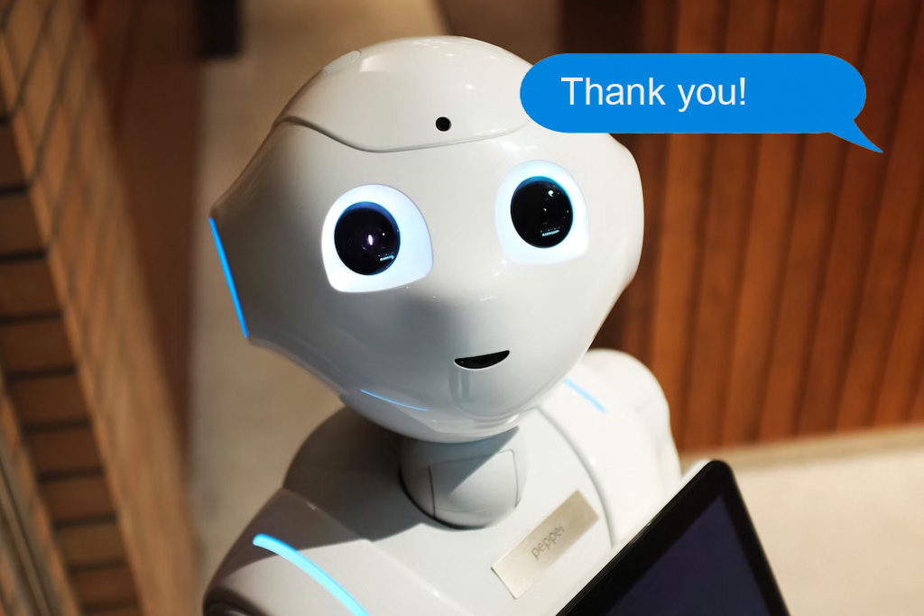
Thank you

